Slide 1

Testing
Aidan McGowan
Testing – an introduction
Unit Testing
JUnit Testing

Slide 2
JUNIT Testing
JUnit is a unit testing framework for the Java programming language.
JUnit is important in the development of test-driven development (TDD) and is one of a family of unit testing frameworks collectively known as xUnit.

Slide 3
Unit tests and unit testing
A unit test is a piece of code written by a developer that executes a specific functionality in the code which is tested. The percentage of code which is tested by unit tests is typically called test coverage.
A unit test targets a small unit of code, e.g. a method or a class.
Unit tests ensure that code works as intended. They are also very helpful to ensure that the code still works as intended in case you need to modify code for fixing a bug or extending functionality.
Having a high test coverage of your code allows you to continue developing features without having to perform lots of manual tests.

Slide 4
Testing - Java projects
Test organisation for Java projects
  Typically unit tests are created in a separate project or separate source folder to avoid normal code and the test code is mixing.
What should you test?
  100% test coverage ?
  All complex code ?
  Getters and setters ?

Slide 5
Testing with JUnit
JUnit in version 4.x is a test framework which uses annotations to identify methods that specify a test. Typically these test methods are contained in a class which is only used for testing. It is typically called a Test class.
JUnit assumes that all test methods can be executed in an arbitrary order. Therefore tests should not depend on other tests.
To write a test with JUnit you annotate a method with the @org.junit.Test annotation and use a method provided by JUnit to check the expected result of the code execution versus the actual result.

Slide 6
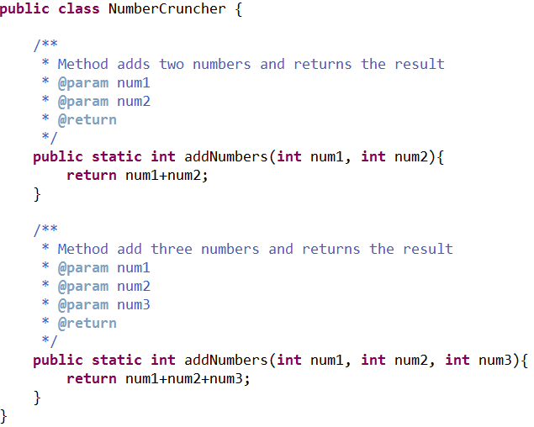
Running a JUNIT Test in Eclipse
Class to be tested

Slide 7
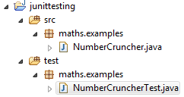
Package Structure for Unit testing
Normally each class has a separate Unit test class
Typically structured…
Class under test
Source folder (for testing)
Package structure for test classes
Unit test class

Slide 8
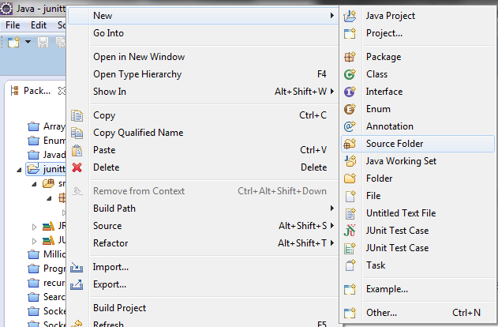
Creating the structure – creating the source folder
Name the folder “test”

Slide 9
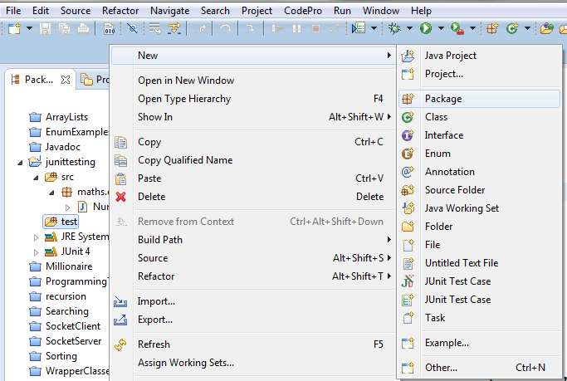
Creating the structure – creating the package structure with the new test folder
Mirror the package naming structure of the class(es) to be tested.

Slide 10
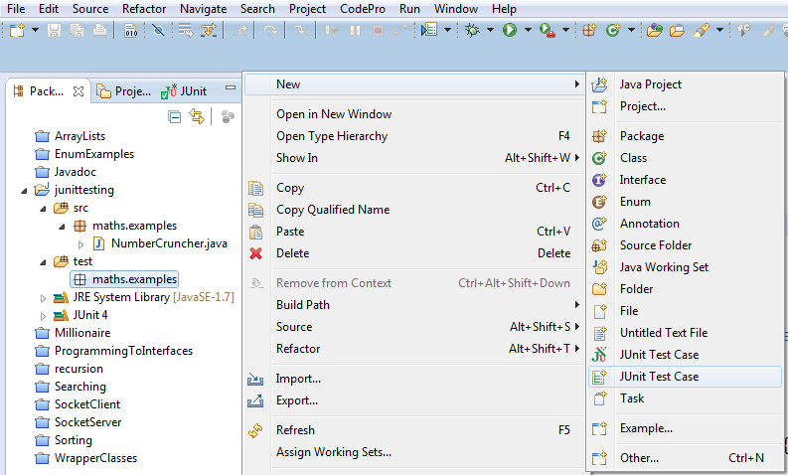
Creating the structure – creating the JUnit Test class

Slide 11
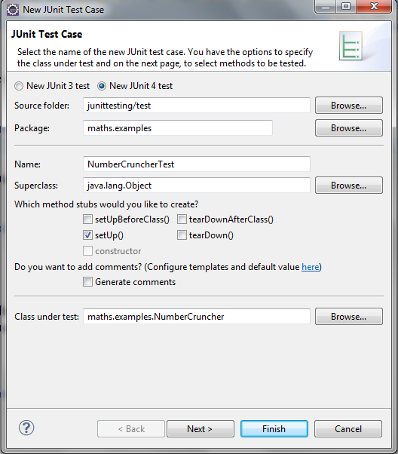
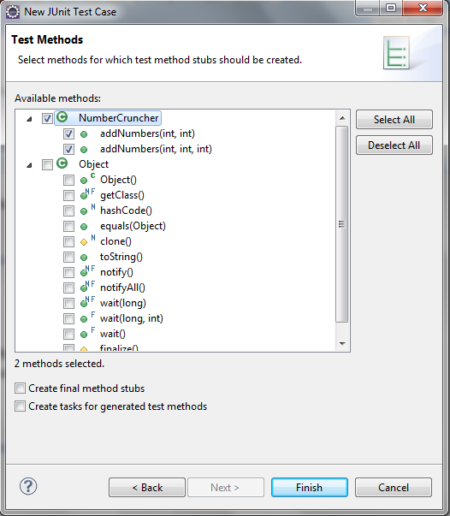
Creating the structure – creating the JUnit Test class

Slide 12
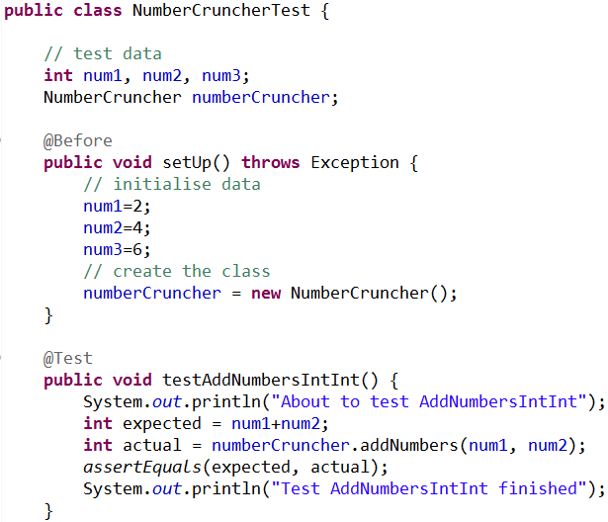

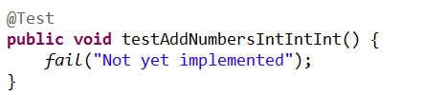
JUnit Test class
Typical imports
Note : not implemented

Slide 13
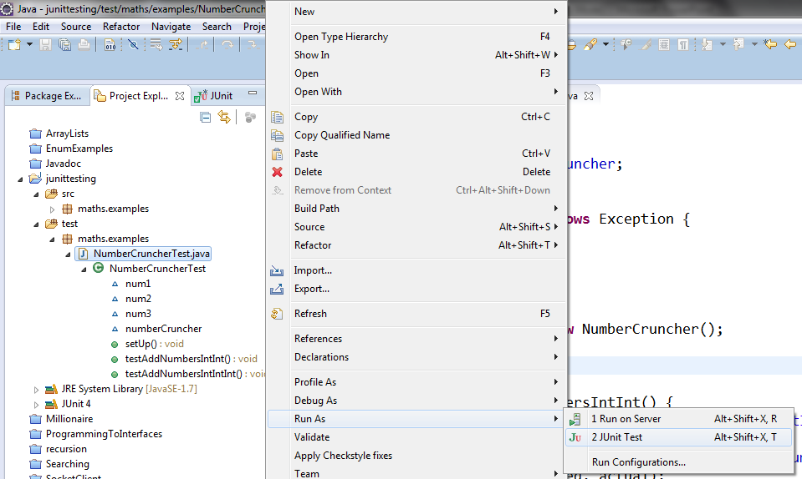
JUnit Test class - running

Slide 14
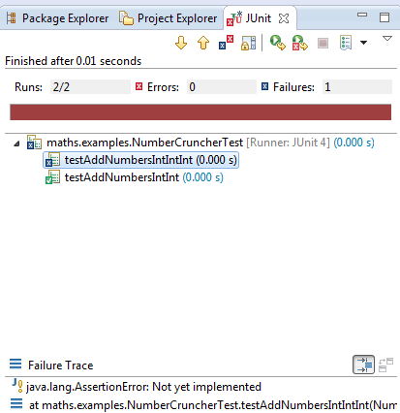
Test run output
Two test cases
One pass
One fail

Slide 15
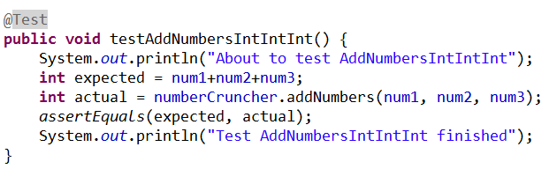
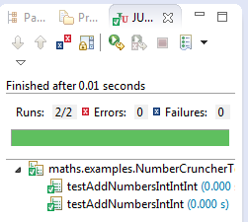
Exercise I – implement the failing test case

Slide 16
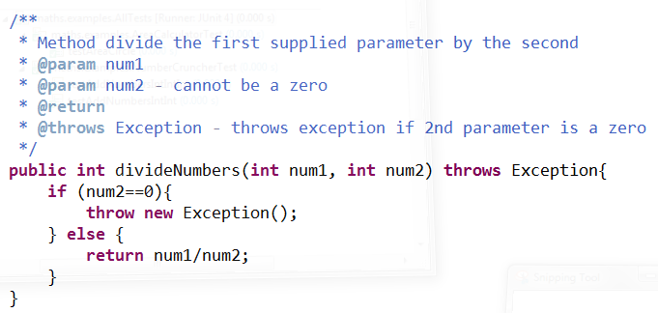
Testing for an exception
This method will throw an exception if the second parameter passed is a zero. This functionality can be tested using JUnit.

Slide 17
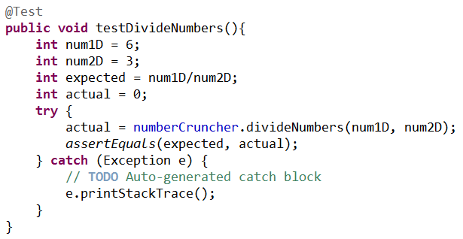
Testing for an exception
Firstly a test case for the normal case (non zero).

Slide 18
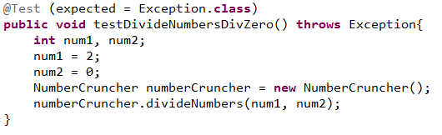
Testing for an exception
Then a test for the exception case.

Slide 19
Annotations used by JUnit
 | Description
@Test public void method() | The annotation @Test identifies that a method is a test method.
@Before public void method() | Will execute the method before each test. This method can prepare the test environment (e.g. read input data, initialise the class).
@After public void method() | Will execute the method after each test. This method can cleanup the test environment (e.g. delete temporary data, restore defaults).
@BeforeClass public void method() | Will execute the method once, before the test cases are ran.
@AfterClass public void method() | Will execute the method once, after all tests have finished. This can be used to perform clean-up activities, for example to disconnect from a database.
@Ignore | Will ignore the test method. This is useful when the underlying code has been changed and the test case has not yet been adapted. Or if the execution time of this test is too long to be included.
@Test (expected = Exception.class) | Fails, if the method does not throw the named exception.
@Test(timeout=100) | Fails, if the method takes longer than 100 milliseconds.

Slide 20
Assert statements
JUnit provides static methods in the Assert class to test for certain conditions.
These assertion methods typically start with assert and allow you to specify the error message, the expected and the actual result.
An assertion method compares the actual value returned by a test to the expected value, and throws an AssertionException if the comparison test fails.

Slide 21
Assert statements
Statement | Description
fail(String) | Let the method fail. Might be used to check that a certain part of the code is not reached. Or to have failing test before the test code is implemented.
assertTrue(true) / assertTrue(false) | Will always be true / false. Can be used to predefine a test result, if the test is not yet implemented.
assertTrue([message], boolean condition) | Checks that the boolean condition is true.
assertsEquals(expected, actual) | Tests that two values are the same. Note: for arrays the reference is checked not the content of the arrays.
assertsEquals(expected, actual, tolerance) | Test that float or double values match. The tolerance is the number of decimals which must be the same.
assertNull([message], object) | Checks that the object is null.
assertNotNull([message], object) | Checks that the object is not null.
assertSame([String], expected, actual) | Checks that both variables refer to the same object.
assertNotSame([String], expected, actual) | Checks that both variables refer to different objects.

Slide 22
Characteristics of a Good Unit Test
Runs fast.
  If the tests are slow, they will not be run often
Separates or simulates environmental dependencies such as databases, file systems, networks, queues and so on.
Is very limited in scope.
  If the test fails, it's obvious where to look for the problem. Use few Assert calls so that the offending code is obvious. It's important to only test one thing in a single test.
Clearly reveals its intention.
  Another developer can look at the test and understand what is expected of the production code.

